Slide 1
Advanced Openacc Course
Office Hour 1: Advanced Profiling, May 26, 2016

Slide 2
May 19: Advanced Profiling of OpenACC Code
May 26: Office Hours
June 2: Advanced multi-GPU Programming with MPI and OpenACC
June 9: Office Hours
Course Syllabus
Recordings:
https://developer.nvidia.com/openacc-advanced-course

Slide 3
Advanced Profiling of Openacc Code
Office Hour 1: Scott Biersdorff, PGI & Jeff Larkin, NVIDIA

Slide 4
Questions from Lecture 1
Is there a way to use OpenACC for Python?
Are OpenACC, CUDA and libraries compatible?
Highly nonlinear problems can be extremely sensitive to order of operations. Does it for OpenACC? If so how does it address the issue?
What should I know about complex routine usage? Where nested functions call this function being marked by routine.
Is it possible to target GPU with some OpenACC pragmas, and multicore with others in the same program?

Slide 5
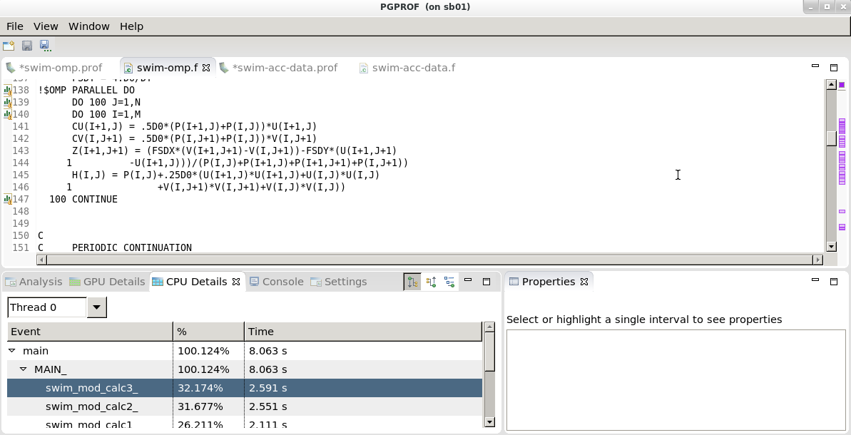
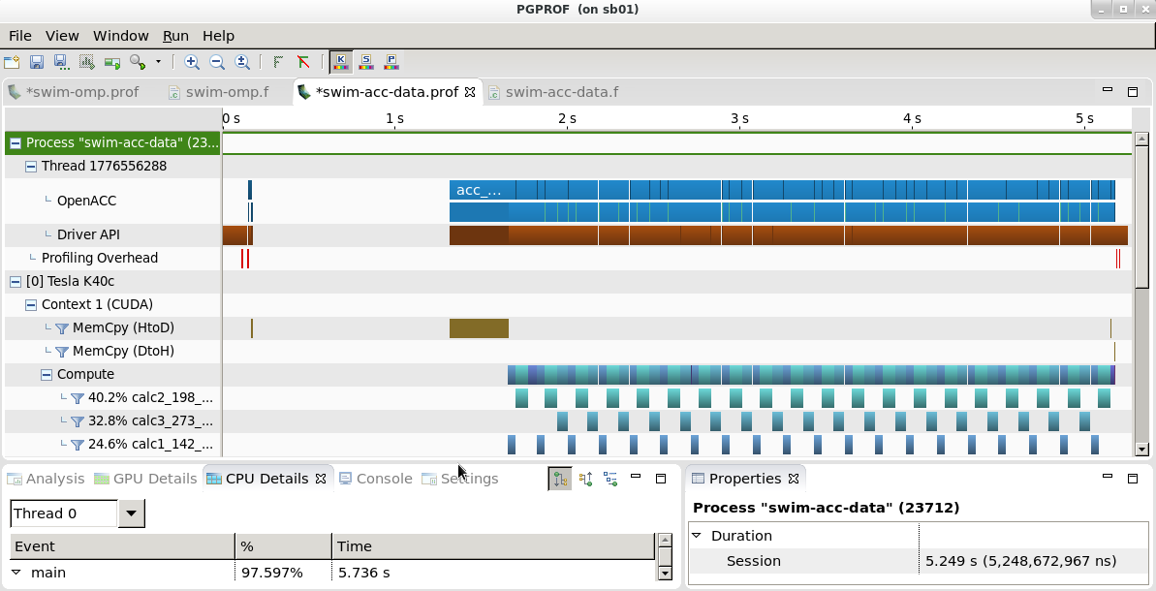
PGPROF: OpenACC CPU and GPU profiler
Available with the latest OpenACC Toolkit
For 64-bit multicore processor-based systems with or without accelerators
Supports thread-level OpenMP profiling
Supports profiling OpenACC and CUDA Fortran codes on NVIDIA CUDA-enabled GPU accelerators
Graphical and command-line user interfaces
Function level (routine) and source code line level profiling
Comprehensive built-in help facilities
http://www.pgroup.com/products/pgprof.htm

Slide 6
Homework
Kirchhoff Migration through Visual PGProf

Slide 7
Where to find help
OpenACC Course Recordings - https://developer.nvidia.com/openacc-courses
PGI Website - http://www.pgroup.com/resources
OpenACC on StackOverflow - http://stackoverflow.com/questions/tagged/openacc
OpenACC Toolkit - http://developer.nvidia.com/openacc-toolkit
Parallel Forall Blog - http://devblogs.nvidia.com/parallelforall/
GPU Technology Conference - http://www.gputechconf.com/
OpenACC Website - http://openacc.org/
Questions? Email openacc@nvidia.com

Slide 8
May 19: Advanced Profiling of OpenACC Code
May 26: Office Hours
June 2: Advanced multi-GPU Programming with MPI and OpenACC
June 9: Office Hours
Course Syllabus
Recordings:
https://developer.nvidia.com/openacc-advanced-course
Questions? Email openacc@nvidia.com

